Slide 1
Contemporary Moral Problems
M-F12:00-1:00SAV 264
Instructor: Benjamin Hole
Email: bvhole@uw.edu
Office Hours: everyday after class

Slide 2
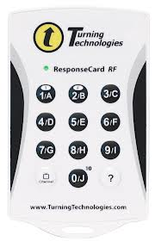

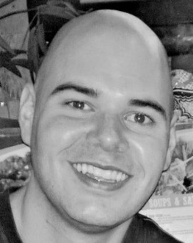
agenda
Clicker Quiz
Peer Review Workshop of Paper Outlines

Slide 3

Singer discusses two versions of a utilitarian ethical principle. He considers:
he considers the stronger version to be correct.
he considers the weaker version to be correct.
he ends up rejecting them both
he claims that they are equivalent.

Slide 4

What was the least difficult part of of designing your final paper outline?
Generating a thesis statement or deciding on a topic
Identifying and reconstructing an exegetical argument
Developing your main argument
Developing the objection to your argument
Developing the response to your objection
Overall argumentative structure (e.g., making sure all of the arguments engage with one another)

Slide 5
What part of your paper is in need of the most work?
Generating a thesis statement or deciding on a topic
Identifying and reconstructing an exegetical argument
Developing your main argument
Developing the objection to your argument
Developing the response to your objection
Overall argumentative structure (e.g., making sure all of the arguments engage with one another)

Slide 6
Peer Review Workshop
Open-ended questions are not “yes or no” questions; instead, they invite your peers to talk about their goals, feelings, or concerns.
Writing and academic conventions questions are leading questions, where you as the reviewer play the role of academic informant and ask questions that “lead” your peer to new conclusions or understandings about writing conventions.
Reviewers can ask clarifying questions from the vantage point of the engaged reader asking the writer to clear up certain elements of her argument/organization.
Reviewers can ask questions to encourage depth of thought and/or point out faulty logic in a peer’s paper.
Follow-up questions are questions that allow you to “check in” with your peers at the end of the review session, and make sure mutual goals were accomplished. This is also where the writer makes plans for revision.

Slide 7
Argumentative Structure
For each argument Is each argument valid in form? Does each argument include all the premises necessary for conclusion? Are the premises sufficient for the conclusion? Are there any premises you might have trouble explaining? (Try to identify the confusion.) | For the overall paper: Is your thesis a strong and simple statement of your core argument’s conclusion? Are you being as charitable as possible in the exegesis? Does your core argument engage with a premise in the argument from the exegesis? Does your objection engage with a premise from your core argument? Is the objection strong (or a straw man)? Does your response to the objection engage with a specific premise? Does your response treat the objection charitably? Does your paper have broader implications in ethical theory?

Slide 8
Plan to revise
Follow-up questions are questions that allow you to “check in” with your peers at the end of the review session, and make sure mutual goals were accomplished. This is also where the writer makes plans for revision.
What feedback has been most useful?
How will you use this feedback when writing your paper?
Which element(s) of your paper need the most work?

